Slide 1
SUPPORT VECTOR MACHINE
BY
ANJALI KADRE

Slide 2
WHAT IS SUPPOT VECTOR MACHINE(SVM)
Support Vector Machine” (SVM) is a supervised machine learning algorithm which can be used for both classification or regression challenges. However, it is mostly used in classification problems
The SVM algorithm helps to find the best line or decision boundary, called hyperplane that classify the data points
It can solve linear and non-linear problems and work well for many practical problems.

Slide 3
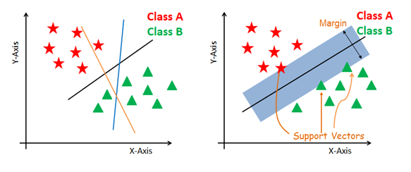

Slide 4
What are different Types of SVM?
1. Linear SVM(LSVM)
2. Non-linear SVM(NLSVM)

Slide 5
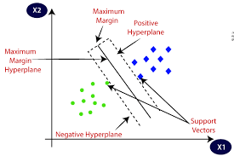
Linear SVM(LSVM)
Linear SVM is used for linearly separable data, which means if a dataset can be classified into two classes by using a single straight line, then such data is termed as linearly separable data, and classifier is used called as Linear SVM classifier.

Slide 6
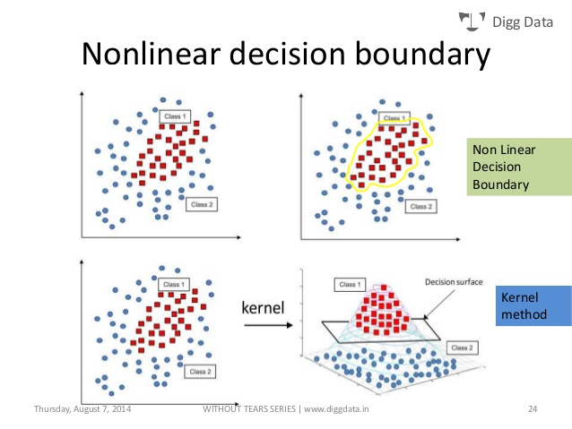
Non-linear SVM(NLSVM)
Non-Linear SVM is used for non-linearly separated data, which means if a dataset cannot be classified by using a straight line, then such data is termed as non-linear data and classifier used is called as Non-linear SVM classifier.

Slide 7
Define Support Vectors, Margin, Hyperplane.
Support Vectors:
The data points or vectors that are the closest to the hyperplane.
SVM algorithm finds the closest point of the lines from both the classes. These points are called support vectors.
Margin:
The distance between the support vectors is called as margin and the goal of SVM is to maximize this margin.
Hyperplane:
The SVM algorithm helps to find the best line or decision boundary, this best boundary or region is called as a hyperplane.
We always create a hyperplane that has a maximum margin, which means the maximum distance between the data points.
The hyperplane with maximum margin is called the optimal hyperplane.

Slide 8
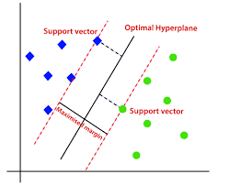

Slide 9
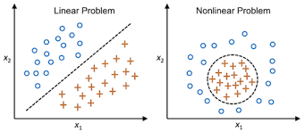
What is the difference between Linearly Separable Dataset & Non-Linearly Separable Dataset?
When we can easily separate data with hyperplane by drawing a straight line is Linear SVM.
When we cannot separate data with a straight line we use Non – Linear SVM. ... It transforms data into another dimension so that the data can be classified is called as Non – Linear SVM.

Slide 10
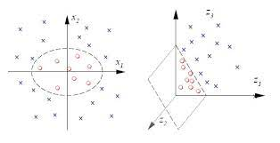
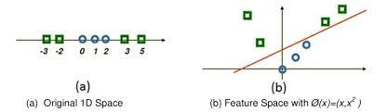
How Kernel Trick is useful in NLSVM?
Kernel” is used due to set of mathematical functions used in Support Vector Machine provides the window to manipulate the data. So, Kernel Function generally transforms the training set of data so that a non-linear decision surface is able to transformed to a linear equation in a higher number of dimension spaces.

Slide 11
Define Kernel
Kernel Trick / Kernel function:
A kernel transforms a low-dimensional input data space into a higher dimensional space.
So, it converts non-linear separable problems to linear separable problems by adding more dimensions to it.
Thus, the kernel trick helps us to build a more accurate classifier. Hence, it is useful in non-linear separation problems.

Slide 12
TYPES OF KERNEL
In the context of SVMs, there are 4 popular kernels
Linear kernel
Polynomial kernel
Radial Basis Function (RBF) kernel
Sigmoid kernel.

Slide 13
Linear Kernel:
It helps to draw a best fit line that separates both the classes linearly.
Linear kernel support vector machines have good performance only on very simple problems.
Polynomial Kernel:
In the polynomial kernel, we simply calculate the dot product by increasing the power of the kernel.
Radial basis function(RBF)
RBF is the most popular support vector machine kernel choice, and the default one used in sklearn.
RBF is short for "radial basis function“. It is a general-purpose kernel; used when there is no prior knowledge about the data.
Sigmoid Kernel:
Mostly, it is used in deep learning, to solve ANN based problems.

Slide 14
C and Gamma
C and Gamma in SVM
Since kernels transforms data into higher-dimensional spaces , machine learning algorithms making use of the kernel trick have a tendency to overfit.
The sklearn SVM methods provide C and gamma functions for this purpose.
C & Gamma is a hypermeter which is set before the training model and used to control error .

Slide 15
Pros and cons of SVM.
PROS
SVM's are very good when we have no idea on the data.
Works well with even unstructured and semi structured data like text, Images and trees.
The kernel trick is real strength of SVM. ...
Unlike in neural networks, SVM is not solved for local optima.

Slide 16
CONS:
Choosing a “good” kernel function is not easy.
Long training time for large datasets.
Difficult to understand and interpret the final model, variable weights and individual impact.
Since the final model is not so easy to see, we can not do small calibrations to the model hence its tough to incorporate our business logic.
The SVM hyper parameters are Cost -C and gamma. It is not that easy to fine-tune these hyper-parameters. It is hard to visualize their impact

Slide 17
THANK YOU

